Slide 1
EDA Final Project Topic: Advertising spending
Group Members:
Athulya Anand
Saranjeet Saluja
Sricharraan Ramaswamy
Notes:
Good Afternoon to one and all. Today, I Athulya Anand along with my teammates Saranjeet Saluja and Sricharraan Ramaswamy will be presenting the initial phase of our Final Project having the topic Advertising Spending.

Slide 2
Project Description and Goals
NEED of the Project:
Advertising is a component of marketing that identifies the customer needs and determines the best to meet those needs.
Click-through rate is a significant component in advertisement marketing.
CTR allows you to better understand your customers by revealing what works and what doesn’t while trying to reach your target demographic.
A low CTR could indicate that you're targeting the wrong audience or that you're not using persuasive language to persuade them to click.
GOALS: We are focusing on the following problem statements:
What is the relationship between the Daily time spent on site and the Daily usage of the Internet ?
How does internet usage or daily time spent on advertisements help understand if the user will click on the ad ?
Identify the parameters like age, gender, etc that affects the probability of clicking on ads.
Notes:
In today’s era, just as the internet has become a part of our everyday life, advertisers have also been using this platform to market and sale their product. Thus, Marketing Analysis plays a significant part in Advertising and involves the identification of their key customers, thereby determining the best ways to satisfy their needs. On the internet platform, advertisers try to focus on the Click through rate – a significant component in advertising marketing. Tracking this CTR gives the advertisers a good understanding of how the customers react to their works and do not respectively. A low CTR indicates that their target is towards the wrong audience and that they must modify their marketing strategy or vice versa. Through this project we predominantly focus on bringing out a relationship between the daily internet usage and probability of clicking on ads by users who use sites on a daily basis. Likewise, we focus on the following problem statements.

Slide 3
The file advertising.csv contains data on 1000 users indicating whether or not a particular internet user clicked on an Advertisement on a company website.
Daily Time Spent on Site: consumer time on-site in minutes
Age: Customer age in years
Area Income: Avg. Income of geographical area of consumer
Daily Internet Usage: Avg. minutes a day consumer is on the internet
Ad Topic Line: Headline of the advertisement
City: City of consumer
Male: Whether or not the consumer was male
Country: Country of consumer
Timestamp: Time at which consumer clicked on Ad or closed window
Clicked on Ad: 0 or 1 indicated clicking on Ad
Dataset Description

Slide 4
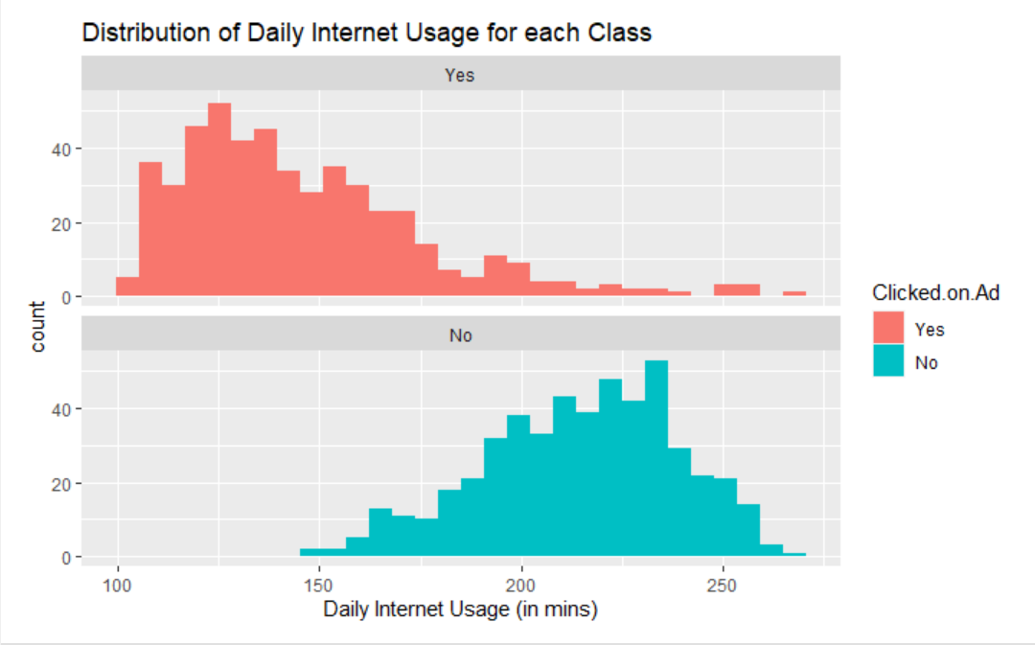
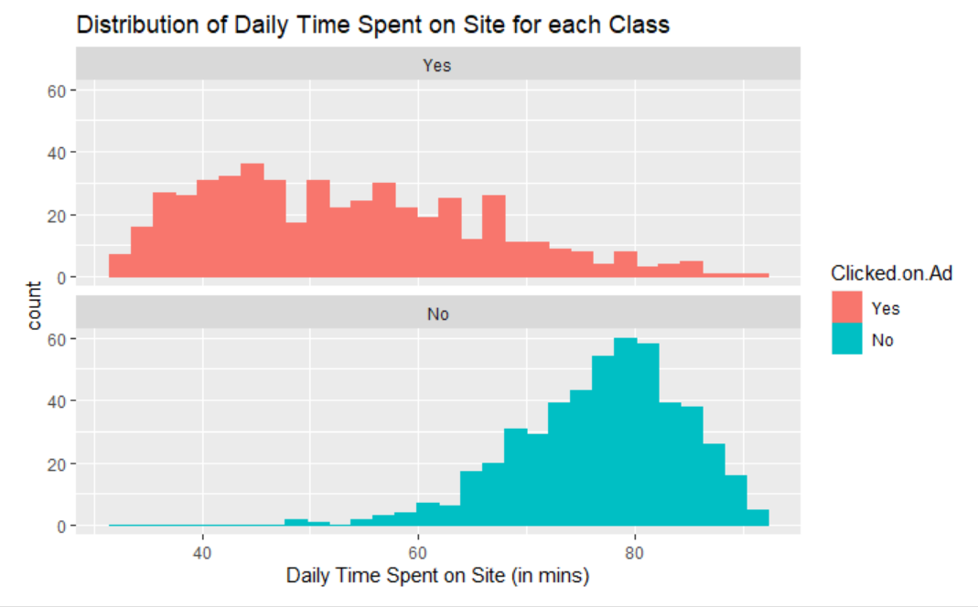
Depicting the Likelihood of Clicking on an Ad
Fig. 1.
Inference from the alongside plots:
In Fig 1., the distributions of daily time spent on site for clicking on ad is kind of right skewed and are very different from the distribution for not clicking on ad.
In Fig 2., the the distributions of daily time spent on site for clicking on ad are very different from the distribution for not clicking on ad which is slightly left skewed.
Fig. 2.

Slide 5
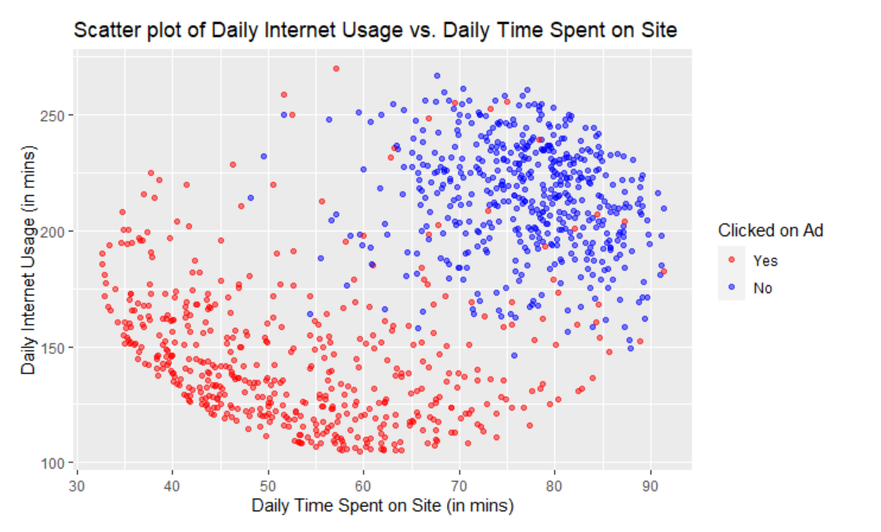
Scatter plot: Daily time spent of site Vs Daily Internet Usage
We aim to identify how the probability of clicking on ads depends on the daily internet usage and daily time spent on site.
Inference from the alongside plot:
Fig 3, shows us a clear distinction of the people who click on ads and those who do not.
Still, it is hard to work on just two variables and make a conclusion.
Thus, we move to plotting a model.
Fig.3.
Notes:
We decided to plot a scatter plot to understand the relationship of Daily time spent on site vs the daily internet usage. As you can see the users who click on ads is represented by Red data points and those who do not is depicted by the blue data points. This plot indicates a clear distinction between those who click on ads and those who do not. It can be inferred that users who spend a relatively low time on sites daily are more likely to click on ads. on the contrary those who spend lesser time on the internet are less likely to click on ads. Additionally, we can also witness a few outliers on this plot when the daily time spent on site is around 60mins. However, it is stil hard to work on just two variables here and draw a conclusion. Further we do a density plot to check the same.

Slide 6
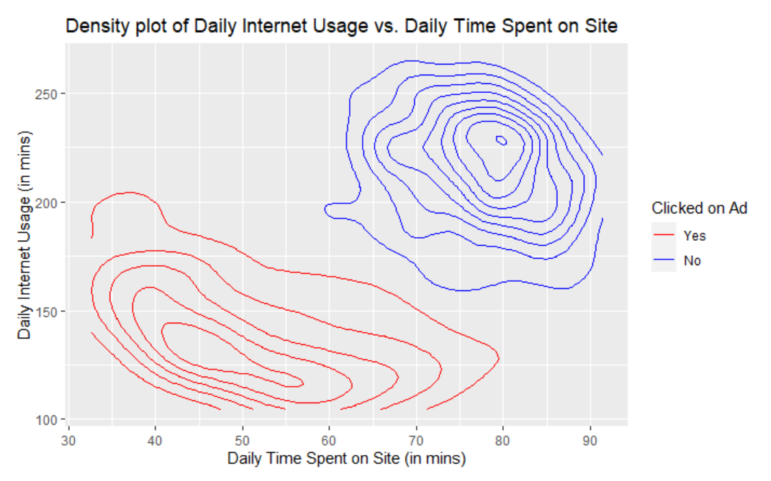
Density Plot: Daily Internet Usage Vs. Daily time spent on site
Density plots are more useful for comparing the two distributions.
Inference from the alongside plot:
Fig 4, There is a clear distinction between those who click on ads and those who do not.
We can observe that people who spend more time on sites and who use the internet for a longer duration do not tend to click on ads.
Fig. 4.
Notes:
This density plot is a better depiction to compare the two distributions. Yet again, we can confirm from this density plot that users spending less time on internet click more on ads than those who spend time on the internet for a relatively longer duration.

Slide 7
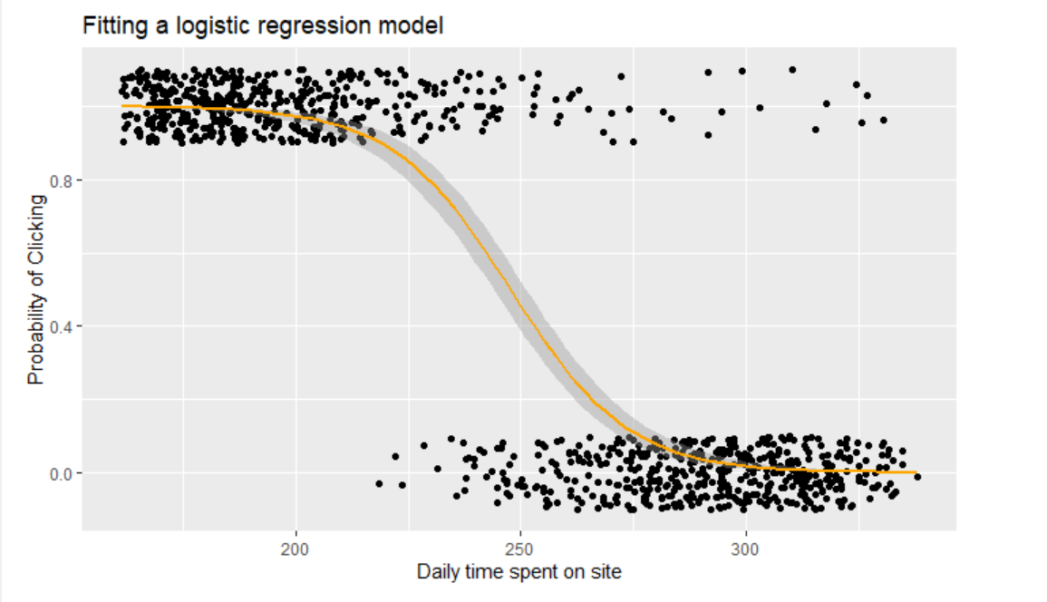
Logistic Regression to predict the probability of clicking an ad
Firstly, we aim to build on simple models and then go to complex models.
In Fig. 5., we start predicting the probability of clicking on ads given the daily time spent on site.
Inference from the alongside plots:
The probability of clicking on Ads decreases as the Daily time spent on the site increases.
Fig. 5.

Slide 8
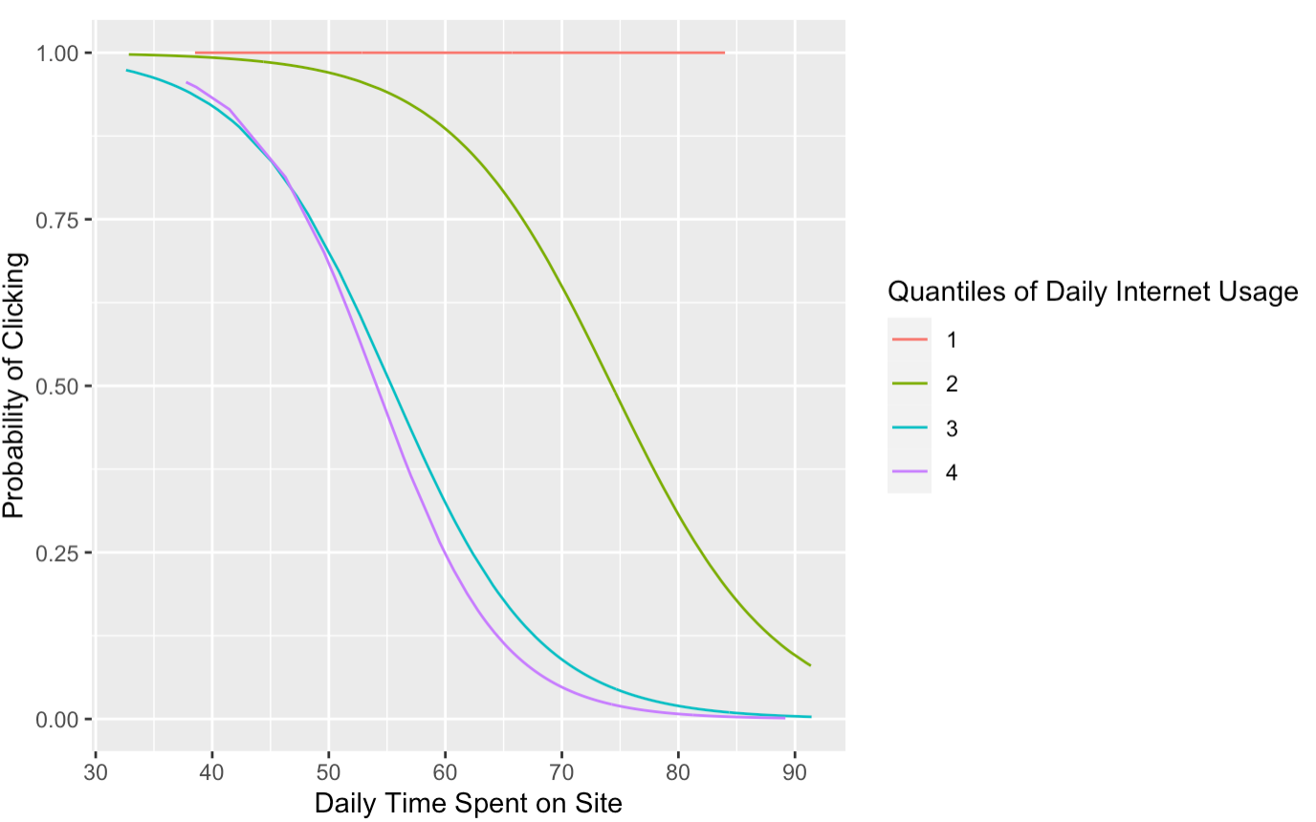
Checking Daily Internet Usage per Quantile
In Fig. 6, we aim to check the change in the probability of clicking on ads, given each interval of Daily Internet Usage.
The four quantiles are represented by:1 - [105,139], 2 - (139,183] , 3 - (183,219] & 4 - (219,270]
Key Inferences from the alongside plots:
Quantile 1- The probability of clicking on the ad is 1 irrespective of the Daily Time Spent on Site.
Quantile 2- The probability of clicking on the ad is close to 1 till Daily Time on Site is up to 50 mins and drops as the Daily Time on Site increases.
Fig. 6.

Slide 9
Future Implementations
Analysis and future modelling building on the current model:
The age wise distribution and the subsequent click on ads.
The gender wise distribution and the subsequent click on ads.

